Slide 1


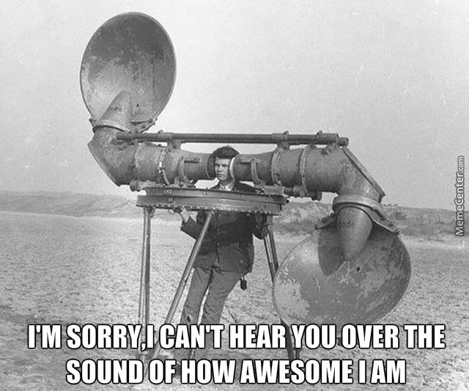
Convolution Neural Network (CNN) for Digital Radio Frequency Memory (DRFM)
Thesis presentation in conformity with the requirements for the degree of Master of Science
EG Friedel
Johns Hopkins University
May 2023
Notes:
Introduce yourself. We have come a long way since the acoustic radar and the radar technology continues to evolve… Couple that with Machine learning which is poised to transform every industry. ML signals the arrival of the next industrial revolution. Theme: It will disrupt the traditional way of doing things. Can we used ML for radars? What things could we envision? What are some difficult problems for radars? The question we propose today is …. Does ML approach work for ECM identification and classification? I’ll admit I’m a radar guy and still learning about AI…excited about the idea and the initial results. This presentation hopes to break down a complex problem into understandable concepts.

Slide 2
Problem Statement
Ideal situation
Ideally radar signal processing should be able to accurately and efficiently detect false or misleading electronic signals.
Reality
Typical radar signal processing is ineffective against false targets produced by electronic jammers. Complex ECM jammers are particularly difficult to detect.
Consequences
Failure to identify false and targets results in the following issues
Impact to system performance due to more signal processing operations
Degrades detection performance
Hides the real targets, deceiving the Tracker
Proposal
Opportunities exist for improved electronic jammer mitigation through machine learning to identify false targets and interference to improve overall radar performance operation.
Optimization problem attempting to minimize $\left(θ^{∗}\right)$ over $L(θ)$ to perform image classification

Slide 3
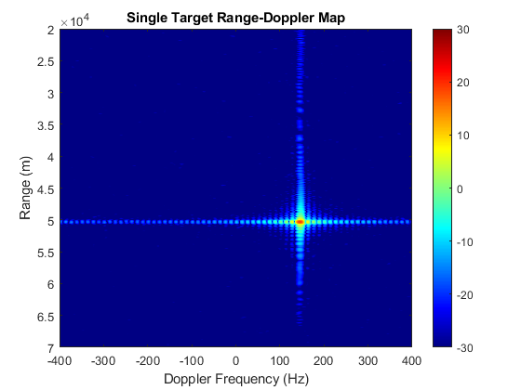
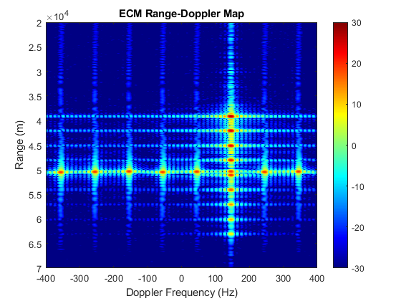
What are you Trying to Do?
Evolve the concept of conventional radar digital signal processing techniques
Use a Machine Learning Approach to identify and classify misleading electronic signals in the radar main-lobe.
Success is defined by the identification of an ECM, in this case a Digital Radio Frequency Memory (DRFM) interferer and its different types via the CNN model.
The new CNN model is proposed to be part of the radar’s signal processing chain.
Notes:
I want to evolve the idea of the conventional radar in the area of signal processing by using complex algorithms and artificial neural networks to train machines/computers so that they can learn from experience, classify and recognize data/images just like a human brain does.

Slide 4

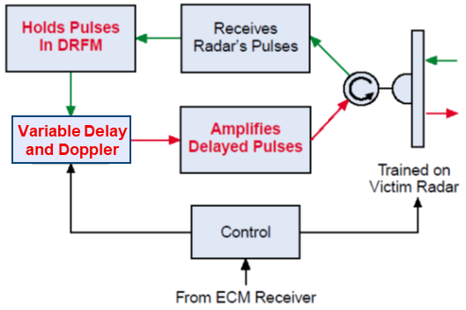
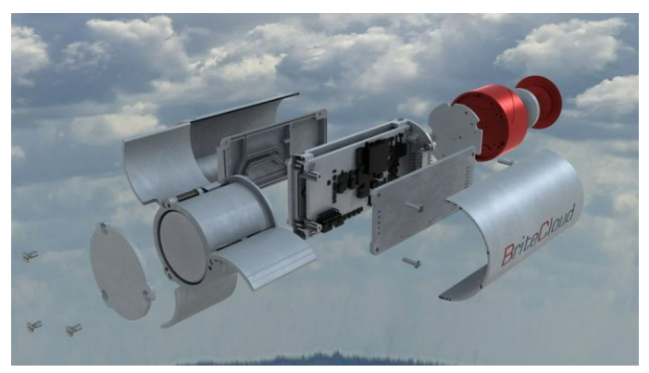

How is it Done Today and Limitations
DRFM Interferer figure from G. W. Stimson, Introduction to Airborne Radar, 2nd Ed
Passive ECM
DRFM
Noise Interference
Deceptive Interference
Spot Noise
Barrage Noise
Random False Targets
Range Bin Masking
Doppler Bin Masking
Range-Doppler Combined
ECM
Active ECM
Communication ECM
Weapon System ECM
Chaff
Decoys
Signature Reduction
Decoys
Expendable Decoys
Towed Decoys
Flares
Electronic Countermeasures (ECM)
Transmitter
False Targets from DRFM Interferer
Impact to system performance due to more signal processing operation
Degrades detection performance
Hides the real targets, deceiving the Tracker
Mission Profile
T/R
Receiver Signal Processing
Receiver
Signal Processor
Detection Processing
Task Scheduler
Radar
Control
Processing
Tracker
Breaks in Receiver Signal Processing
(False Targets are passed through)
Typical Radar
General Solution: Identify Target Interference as Abnormal and Report to Detection Processing

Slide 5
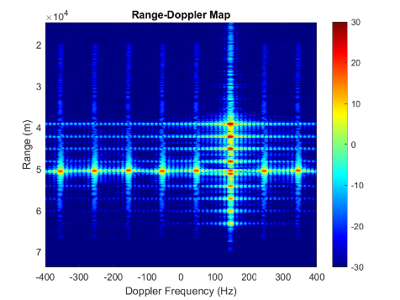
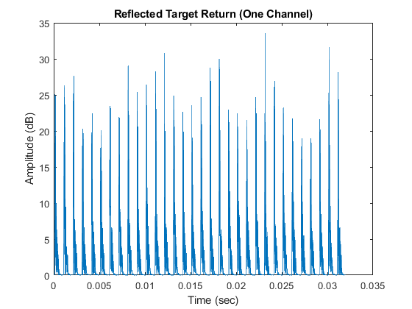
Receiver Signal Processing Chain
Receiver Signal Processing
Breaks in Receiver Signal Processing
(False Targets are passed through)
Signal Processor
Detection Processing
Identify and Classify
Apply CNN at the output of
Range Doppler Processing
Matched Filter
Baseband IQ Data
Replica Multiply
IFFT
Range Doppler Processing
Output
FFT
Output
Detections Processing
Range Cell Detection
Investigate ID of False Targets in the Time Domain for CNN
Detections Processing of Real/False Targets
Notes:
Apply CNN … here is the disruptive part effecting the normal operation that I believe will have a big impact on how radars of the future handle image classification. Bayesian is the typical approach here (which we will not detail here) but it relies on a preliminary assumption that a probability distribution can definitely be assigned to any parameter of a statistical problem, hence the idea of an adaptative approach that can learn seems more appealing.

Slide 6
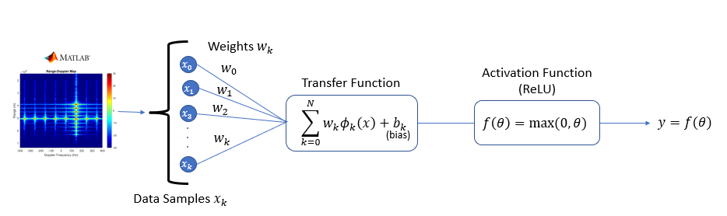
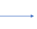
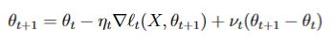
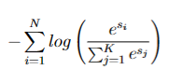
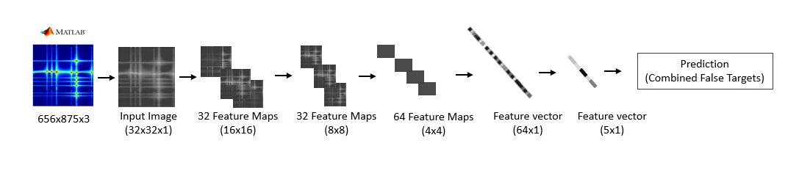
Convolutional Neural Network (CNN)
Prediction
Adaptive Learning Rate and Momentum
(ALRM)
Cross-entropy Loss Function w/ Softmax
Supervised learning
Feature Extraction
Classification
Notes:
What is new and different? Why will this work? The difference between the predicted value and actual value (error) will be propagated backward by updating each node's weights according to the amount of error in each node, this get approximated by the SGD. Backpropagation is a process involved in training a neural network. It involves taking the error rate of a forward propagation and feeding this loss backward through the neural network layers to fine-tune the weights.
The optimization function, Quasi-Newton method based on L-BFGS gradient descent in our example, will help us find the weights that will hopefully yield a smaller loss in the next iteration. We’re going to use the batch ALRM to determine in what direction we should adjust the weights to get a lower loss than our current one. Finally, we’ll set the adjust the learning rate based on the error tolerance and momentum all the weights will be initialized to one.

Slide 7
Methodology of Test
Phase 1: Initialization
Test initial conditions on closed-form non-convex functions with synthetic data
Quick tests designed to confirm the ALRM method is viable and produces accurate predictions
Phase 2: Architecture and hyperparameters selection
Baseline with an established dataset (CIFAR-10) to address data integrity and bias
Adapt a ResNet Architectures approach thus reducing the set of hyperparameters (i.e kernel size, convolutional layers, max, and average pooling)
Iterate through Epochs and monitor the accuracy and loss of the training and test data
Test to confirm that the model can learn!
Phase 3: Main testing on Range-Doppler Images

Slide 8
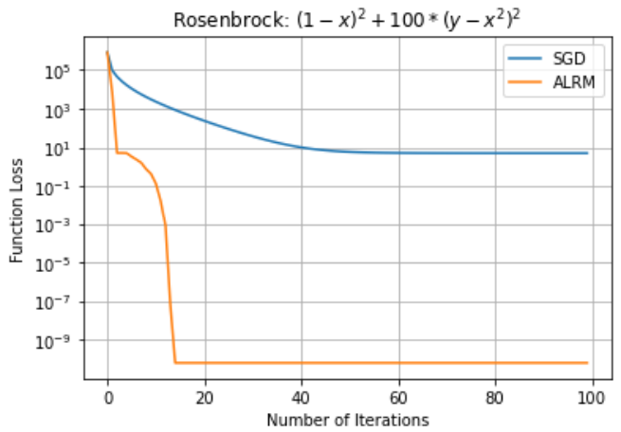
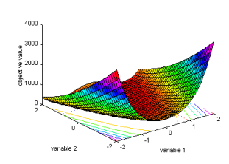
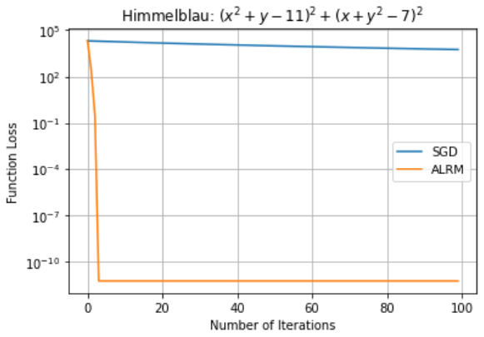
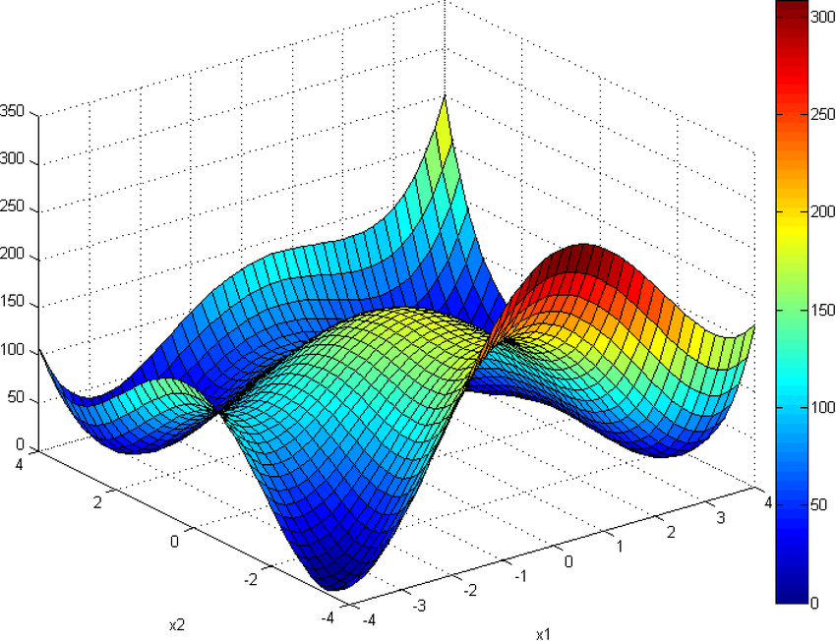
Phase 1 Testing (Non-Convex Functions Results)
Rosenbrock
Testing for accurate predictions
These ran in a couple of seconds and provided unexpectedly good results
Himmelblau
Notes:
Just compare to the closed form solution to judge model performance at each iteration. Show this

Slide 9
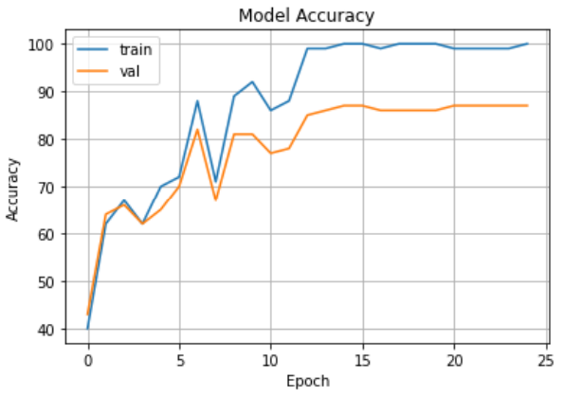
Phase 2 Testing (CIFAR-10 Results)
Results here are promising and very good, achieving an overall training accuracy of 100% and testing accuracy of 87%
There is still a little overfit that needs to be addressed but overall, the results are encouraging.
Accuracy of plane : 87 % Accuracy of car : 86 % Accuracy of bird : 92 % Accuracy of cat : 59 % Accuracy of deer : 92 % Accuracy of dog : 69 % Accuracy of frog : 68 % Accuracy of horse : 92 % Accuracy of ship : 85 % Accuracy of truck : 94 %

Slide 10
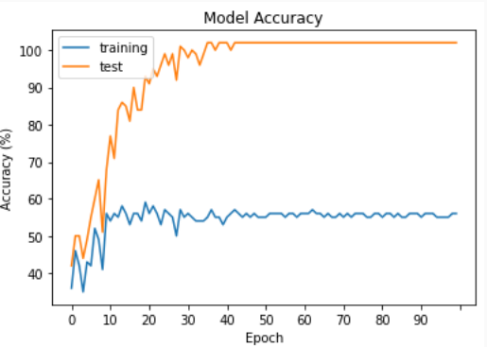
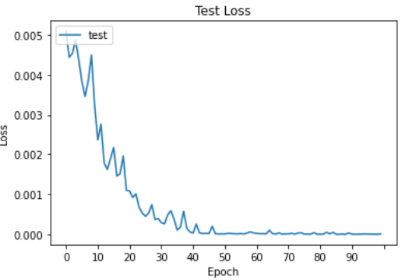
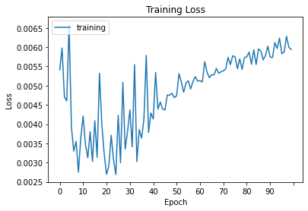
Phase 3 Experiment (Range-Doppler Results)
Results found here are poor and have extreme overfit
The lack of data seems to contribute to an ill-conditioned problem
Does not generalize well to the test data
A limiting effect could be due to the constrained set of testing possibilities that we proposed and thus need to be expanded for more challenging problems.

Slide 11
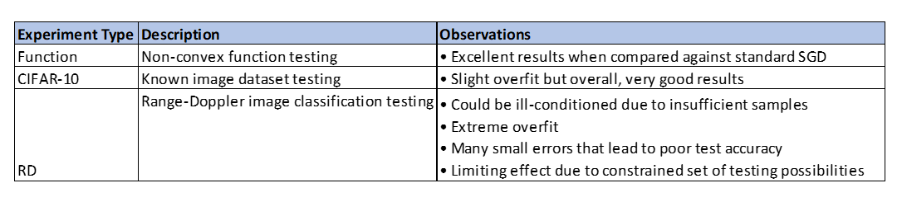
Results Summary

Slide 12
Success what difference will it make?
Opens the door to Machine Learning techniques that demonstrate better radar operational performance and computational saving over existing techniques for radar signal processing
Identification and classification is the first step for applying machine learning techniques to radar signal processing
CNN has been demonstrated in current research as a good and accurate approach for radar signal classification
Adapting to recognition of DRFM targets by moving from a knowledge-based system (domain knowledge) to a learned knowledge approach
An accurate CNN model is a highly attractive solution for non-liner expression capability

Slide 13
Risks
CNN model accuracy is highly dependent on the training data. Bad training data will produce bad results, also overfitting can occur
Large datasets are typically required to train the neural network. Some architectures can be very complex with many layers
CNN works only on images input and does not work well with time-series data

Slide 14

Other Areas of Exploration (Future Work)
Image Segmentation to separate potentially the real and false targets
Design a machine learning approach for time series data
Expand the training data to many other types of interference and interference
Expand the training dataset for range-Doppler images
Explore other Neural networks and predictive behavior techniques

Slide 15
Background

Slide 16
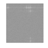
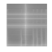

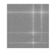
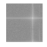
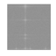
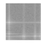
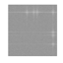
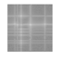
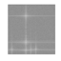
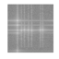
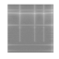
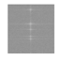
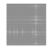
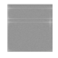
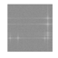
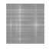
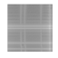
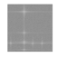
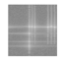
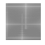
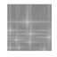
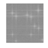
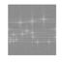
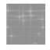
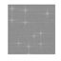
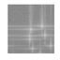
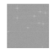
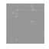
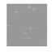









































































































































































Samples of Training Data
DRFM Categories
Range-Doppler Images
Combined masking
Random masking
Range Bin masking
Doppler Bin masking
Doppler Bin masking
Combined masking
Random masking
Range Bin masking
Random masking
Interference

Slide 17
AI
Artificial Intelligence
Machine Learning
Neural Networks
Deep Learning
CNN
Any technique that allows a machine or computer to solve tasks in a human like way.
Gives a computer the ability to learn without explicitly being programmed.
Machine learning models based on the way a human brain learns.
A machine learning approach that uses several layers of neural networks to build data representations.
A deep learning approach using convolutional neural networks.

Slide 18

ALRM

Slide 19

Quasi-Newton Method

Slide 20

Stochastic Heavy-ball Method

Slide 21


ResNet Architectures
Link back

Slide 22
What are your main contributions?
A new CNN model or solution for DRFM jammers
A novel method using stochastic techniques for detection processing for the separation of false and real targets
What trades or experiments did you perform?
Any Limitations?
Future Work …

Slide 23
Why use Neural Networks to solve this problem?
Helps to support the idea of jamming suppression prior to detection processing
Plan to show that CNN feature extraction of DRFM jamming signals can be more efficient and superior then conventional radar signal processing techniques
An accurate CNN model is a highly attractive solution for a non-linear expression capability. This is what we hope to achieve!
We frame this as a target detection problem that can be addressed with image classification. CNNs have made great progress in this area along with computer vision. So, machine learning in general seems to be a good fit for this problem.

Slide 24
Where does the standard approach break?
Due to the strong correlation of the false target to the transmitted signal, the matched filter gets applied and thus processed as a real target.
The matched filter is the basic technique used for most radar signal processing designs.
Main-lobe jamming is difficult to detect because of the matched filter processing used by the radar.
Loss of target information and model mismatch are problematic when a radar is being jammed. The standard parametric approach is ill-fitted because it relies apriori mission information.
We should investigate more closely other detection methods to support the matched filter. The problem is the false targets are in the main-lobe of the beam.
Waveform or frequency agility would change the replica of the matched filter, but this would not help for DRFM false targets which matches the transmitted pulse of the radar
Adaptive waveforms are used to put the false targets in null of the beam however in this case, you would lose your real target and thus should not be used
CFAR will help with false alarms and some false targets by adjusting the detection threshold level but would have little to no effect on main-lobe detections near or exceeding the real target SNR.

Slide 25


Beamformer Adaption for Noise Jammer
Prior work done to help address noise jammers, where the angle of interference is known

Slide 26

Deceptive Jammer Top-level Architecture
Rx
Rx
Tx
Tx
~
ES
(Digital Rx)
Memory
WF Generator
DAC
Electronic Support Measures
Technique Generator
Electronic Attack
Typically uses digital radio frequency memory (DRFM)
Captures the victim waveform and applies delays and/or Doppler shifts to the waveform before retransmitting it (e.g. range gate stealer, velocity gate stealer)
Tx and Rx antennas can be shared or separate – periodic monitoring of the environment is required
Exploits coherence with the victim radar to reduce jammer power requirements

Slide 27
Cover Pulse
To test a cell in the center of here
target detection missed
Estimate local noise over the cells outside here but inside here
Normalize cell by noise floor estimate; compare to threshold
Cover pulse uses a transponder that produces range-gated noise triggered off of the pulses received from the radar
Improves energy efficiency of the jamming by enabling it to reduce the average power needed to ‘cover’ the target
Cover pulse captures the CFAR noise floor estimate resulting in a missed detection
Typical J/S of 10-40 dB
Transponder
Block diagram from G. W. Stimson, Introduction to Airborne Radar, Scitech, 1998

Slide 28
Bin Masking
Repeater for producing range bin masking
Range Bin Masking
Range bin masking denies victim radar the target range – often used in low and medium PRF radars
Doppler bin masking denies radar target Doppler
Typically used against medium and high PRF systems
Can produce using a variety of slow-time phase modulations
Straight-through Repeater for producing Doppler bin masking
Doppler Bin Masking
Block diagrams from G. W. Stimson, Introduction to Airborne Radar, 2nd Ed Scitech, 1998

Slide 29
Range and Doppler Bin Masking
To test a cell in the center of here
with jamming
detection missed
Estimate local noise over the cells outside here but inside here
Normalize cell by noise floor estimate; compare to threshold
Can mask multiple range and Doppler bins at once
Range and Doppler bin masking can capture typical CA CFAR and prevent detection of the skin
Can be produced using DRFM-based repeater
Typical J/S of 10-20 dB
without jamming

Slide 30
False Target Range-Doppler Maps
Various false target configurations are possible depending on the jammer sophistication

Slide 31
False Target CA CFAR Maps
False target returns can consume radar resources as additional confirm dwells and tracks must be pursued
Additionally, a high-power stand-off jammer can inject false targets into the sidelobes, providing a form of angle deception (though this can be countered)

Slide 32
Gate Pull-off Illustration
FT initially on top of target, significantly stronger than skin return
As FT pulls off the target, it takes the track window with it; can suppress true target in CFAR output
FT pulls track window off target – even though target is now detectable, radar is only looking in the window

Slide 33


Sidelobe Blanking
mainbeam output
guard channel output
nominal mainbeam-to-sidelobe ratio
mainbeam ouput $≫$ guard channel output
ðmainbeam detection
Compare output of mainbeam and guard channel
If the difference exceeds a design threshold, a mainbeam detection is declared
If the difference does not exceed the threshold, a sidelobe detection is declared – potential false target injected into sidelobes
mainbeam output
guard channel output
mainbeam ouput $≈$ guard channel output
ð sidelobe detection
Figure modified from G. W. Stimson, Introduction to Airborne Radar, Scitech, 1998

Slide 34
Jittered PRI
solid – true target; dashed – false target
Change PRI from one pulse to the next
Prevents deception jamming from generating consistent false targets from pulse-to-pulse
True targets will resolve to consistent ranges
Leading false targets get rejected
Amount of jitter will be limited if using pulse-Doppler operation
Clutter cancellation is similarly complicated – modulation of clutter results in greater Doppler spread
On the order of 5% jitter may still allow for pulse-Doppler operation – need sufficient range resolution to detect resulting range inconstancies

Slide 35


Mask Detection
Recall (continuous) noise jamming detector
Perform on envelop-detected cells
Choose a test region that covers a wide area to distinguish noise jamming from localized interference
If $M$ cells out of $N$ cells tested exceed a threshold $V_{t}$ then noise jamming is declared
‘Local’ masking (cover pulse, bin masking) and false target jamming will fail this test and not be detected
Solution (for masking)
Perform the dual-threshold test over localized regions
Use ordered statistic detector
Notional Search Mode Test Region
(high-altitude, no clutter case)
range
Doppler

Slide 36

Other Pull-off Detection Techniques
Harmonics detection
VGPO and R-VGPO use modulation to produce velocity walk-off
If the modulation is not perfectly clean, it can, coupled with the large signal required, produce harmonics in the return
Provides a jamming indication
RCS Measurements
RGPO or VGPO uses a large signal return to capture the tracking window
This sudden increase in signal power can be an indication of jamming (need to guard against false alarms)
before jamming
after jamming starts

Slide 37
False Target Detection
Doppler false targets often periodic in frequency and centered about the true target
Doppler false targets are all at the same range, can track target in range / discriminate in tracker
Numerous targets that all have the same angle of arrival (to within the measurement error of the system) are candidate false targets
Exploit tracking over time to detect inconsistencies between the range and Doppler measurements of the false target (also for pull-off techniques)
Track measured RCS
false target signals will typically have unrealistic statistics over time
e.g., the measured RCS will exhibit less fluctuation since the jammer wants the radar to see the target with few missed detections due to fluctuations in order to keep the display flooded

Slide 38

Leading Edge Detection Cover Pulse
CA CFAR
cell-averaging CFAR
Use average of cells over a window as the noise floor estimate
TM CFAR
Trimmed-mean CFAR
Excise top $P_{high}$ and bottom $P_{low}$ cells from window prior to averaging
$P_{low}=P_{high}=0.5$ gives the median CFAR
CFAR output gives some indication of jamming
Since jammer response cannot precede target response, CFAR noise floor estimate indicates the jammer range

Slide 39
Bin Mask Leading Edge Detection
Mask raises the CFAR noise estimate, causing a missed detection
Median CFAR provides more of an indication of the mask shape
CFAR mask = 5 Dop x 13 range gates (use every other range gate)
If the leading edge of the mask can be detected, the range to the jammer can be measured
Key is to determine the appropriate technique to identify the leading edge of the mask
Note – techniques that use ‘prediction’ to go up range of the jammer will negate leading edge tracking
CFAR mask = 25 Dop x 1 range gate (use every other Dop filt)
Leading edge of mask better revealed with median CFAR

Slide 40
Summary
Deceptive jammers try to confuse radar
Hide skin return (similar to noise jamming)
Overwhelming detection processing (false targets)
Deceive tracker
No single EP technique; use multiple approaches including:
Make radar waveforms difficult to identify
Various radar waveforms (HPRF, MPRF, different pulse widths)
Short time on RF
Wide bandwidth (jammer needs to find radar)
Recognize jamming returns as ‘abnormal’
Report degraded performance
Reset to target skin return
Difference between Kalman and Doppler trackers can trigger pull-off detection
Build in EP from the beginning – hardware and software
Additional techniques to consider include LPI waveforms and power management
Multiple complimentary sensors – each has its own weaknesses and strengths (see table at right)
EA & EP discussed these modules is not exhaustive – other techniques can be employed
Table from G. W. Stimson, Introduction to Airborne Radar, 2nd Ed, Scitech, 1998
Red bold indicates potential vulnerabilities

Slide 41
References
G. W. Stimson, Introduction to Airborne Radar, 2nd Edition, SciTech, 1998
G. W. Stimson, Introduction to Airborne Radar, 3rd Edition, IET, 2014
D. K. Barton, Radar System Analysis and Modeling, Artech House
R. N. Lothe, M. B. Szymanski, and R. G. Wiley, Radar Vulnerability to Jamming, Artech House
R. G. Wiley, ELINT, The Interception and Analysis of Radar Signals, Artech House
M. I. Skolnik, Ed., Radar Handbook, McGraw-Hill
A. Partizian, “Electronic protection,” in Principles of Modern Radar, Vol. II: Advanced Techniques, W. L. Melvin and J. A. Scheer, Eds. Edison, NJ: SciTech Publishing, 2013, ch. 12, pp. 529-585
S. L. Johnston, “Radar electronic counter-countermeasures, IEEE Transactions on Aerospace and Electronic Systems, January, 1978
Electronic Warfare, Joint Publication 3-13.1, https://www.hsdl.org/?abstract&did=469779
Joint Electromagnetic Spectrum Operations, Joint Publication 3-85, https://www.jcs.mil/Doctrine/Joint-Doctrine-Pubs/3-0-Operations-Series/
Electronic Warfare and Radar Systems Engineering Handbook, https://apps.dtic.mil/dtic/tr/fulltext/u2/a617071.pdf
Electronic Warfare Fundamentals, http://falcon.blu3wolf.com/Docs/Electronic-Warfare-Fundamentals.pdf
https://www.radartutorial.eu/16.eccm/ja05.en.html

